Slide 1

Online Face Recognition Attendance System
By
(I) YASH RAJ ANAND (12020002001016)
(II) RISHABH (12020002001018)
(B.Tech 4th Year 7th semester)
Under the Supervision of
Prof. (DR.) G. UMA DEVI
Dept. of Computer Science & Engineering
University of Engineering & Management, Jaipur

Slide 2
Outlines
Introduction
Aim & Objectives
Proposed Model
Experimental Setup
Conclusion & Future Scope
Acknowledgement

Slide 3
Introduction
The Online Face Recognition Attendance System represents a cutting-edge advancement in attendance management, harnessing the power of facial recognition technology to revolutionize the way organizations track and monitor attendance. At its core, the system begins with the enrollment phase, where individuals are registered by capturing their facial features, generating unique biometric templates that serve as digital signatures for identification. These templates are securely stored in a database, forming a comprehensive reference for real-time comparisons during attendance tracking

Slide 4
Aim & Objectives
The Online Face Recognition Attendance System aims to revolutionize attendance management by deploying highly accurate facial recognition algorithms, ensuring precision in identifying individuals and minimizing errors. By automating the attendance process, the system enhances efficiency and reduces the time and effort associated with manual tracking methods. Prioritizing a contactless experience, it eliminates the need for physical contact or additional devices during attendance marking. Robust security measures safeguard facial data, granting access only to authorized personnel and complying with privacy regulations. The system features an intuitive and user-friendly interface for administrators and end-users, fostering a positive experience. Seamless integration with existing organizational systems is enabled, allowing for easy adoption. Real-time monitoring and automated reporting provide administrators with comprehensive attendance insights. The system is designed to be scalable, accommodating varying organizational needs, and exhibits adaptability to different environments and user demographics. Educational initiatives aim to inform users and administrators about system functionalities and ethical considerations, fostering understanding and acceptance within the user community.

Slide 5
Experimental Set-up
Minimum requirement:-(i) windows 7 OS
(ii) 4 GB Ram
(iii) 160 GB Hard disk
Software setup:- (i) VS CODE
(ii) Python
Modules used (i) TKinter
(ii) messagebox
(iii) mailparser
(iv) tkinter.simpledialog
(v) cv2 (OpenCV)
(vi) OS
(vii) csv
(viii) NumPY

Slide 6
Proposed Model
The proposed Online Face Recognition Attendance System aims to overcome traditional attendance management limitations by integrating advanced facial recognition technology. Key components include a sophisticated facial recognition algorithm, secure biometric data storage, real-time processing for instant attendance tracking, a user-friendly enrollment system, robust attendance logging, and reporting. Seamless integration with existing systems, an intuitive user interface, and stringent security measures are prioritized. The system is designed for scalability and adaptability, accommodating diverse user loads and environments. Training and support resources ensure a smooth transition. The model envisions a comprehensive solution, leveraging facial recognition to redefine attendance management for educational, corporate, and organizational settings, offering security, efficiency, and user convenience.

Slide 7
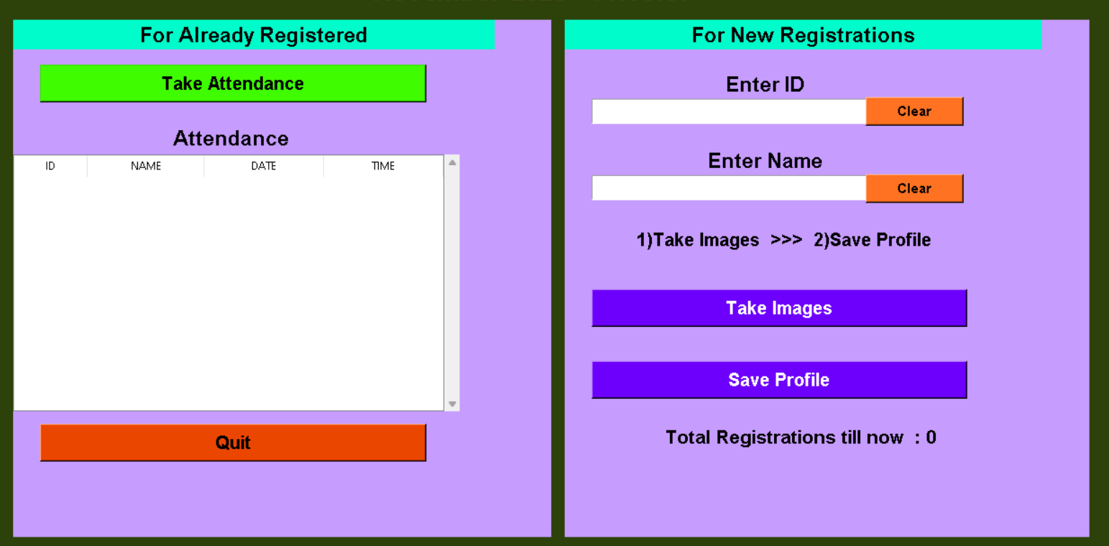
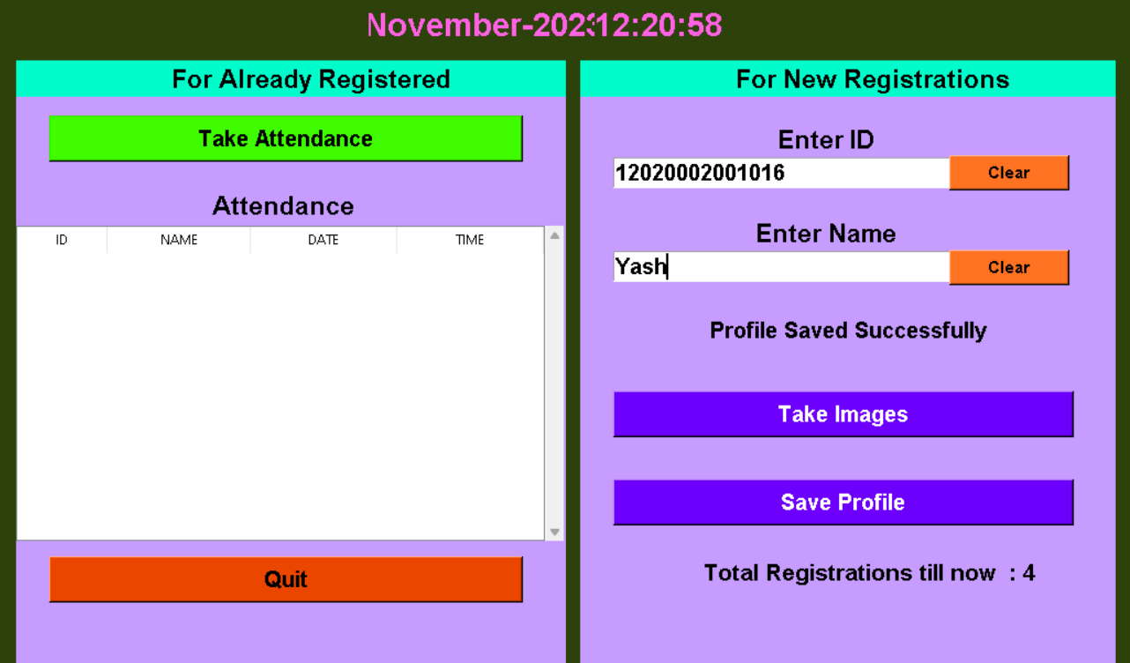
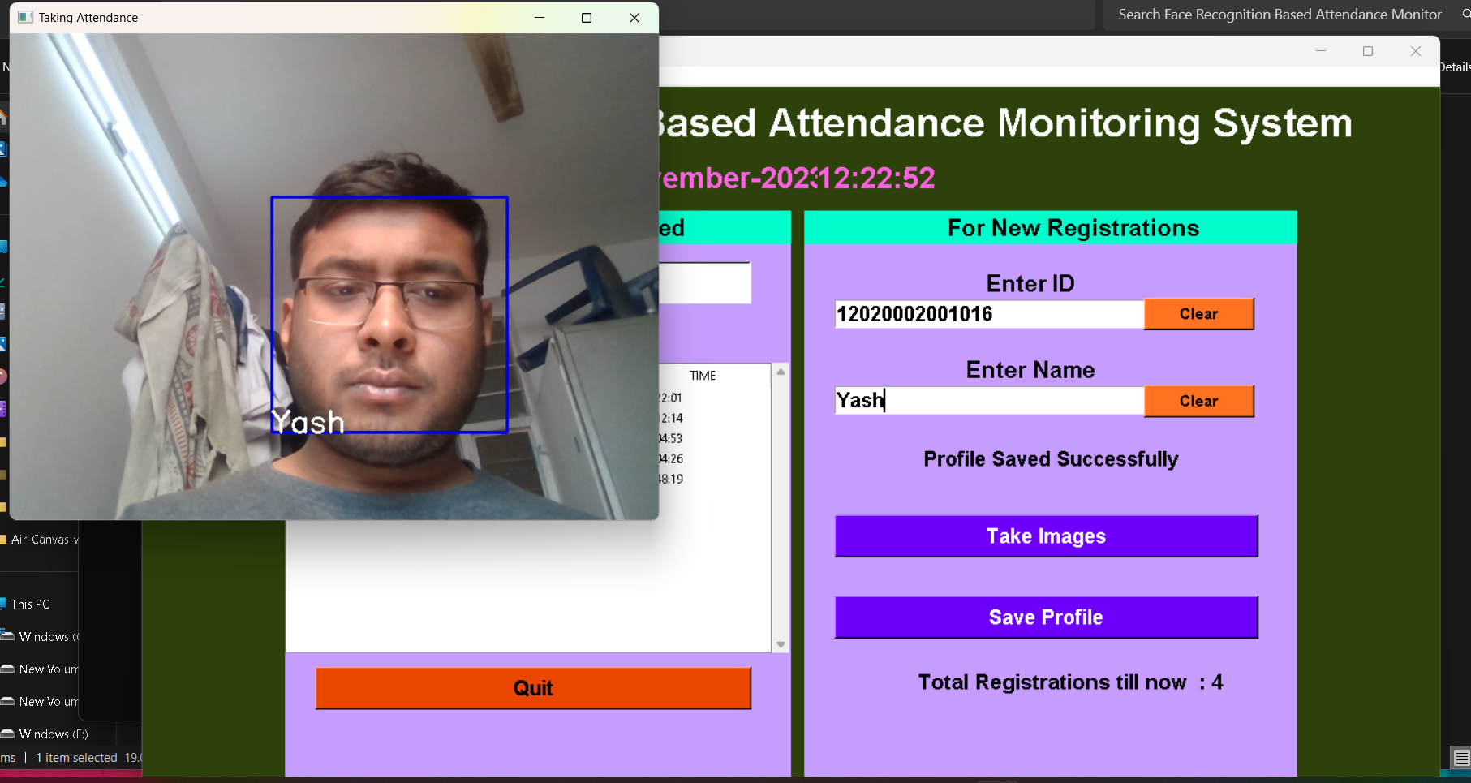
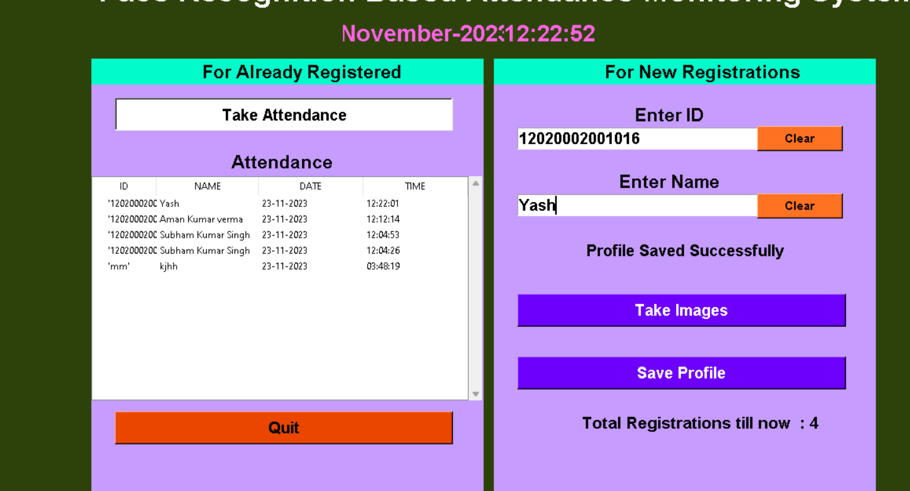


Result: Example

Slide 8
Limitation
The proposed Online Face Recognition Attendance System, while offering innovative solutions, comes with several inherent limitations. Privacy concerns emerge as a primary issue, given the sensitive nature of biometric data collection and storage. Accuracy challenges in varying lighting conditions and potential biases within the facial recognition algorithms may lead to inaccurate attendance tracking, raising questions about fairness. Security vulnerabilities pose a significant risk, with the centralized storage of biometric data susceptible to breaches and unauthorized access. User enrollment might be cumbersome, potentially impacting user acceptance. The high initial implementation costs, legal and regulatory compliance challenges, and the system's dependence on technology introduce additional hurdles. Moreover, there's the risk of limited adaptability, as facial recognition systems may struggle to accurately recognize diverse user demographics, leading to potential disparities in attendance tracking. These limitations highlight the importance of addressing ethical, privacy, and technical considerations in the development and deployment of facial recognition-based attendance systems.

Slide 9
Conclusions & Future Scope
In conclusion, the Online Face Recognition Attendance System marks a transformative shift in attendance management paradigms. By leveraging cutting-edge facial recognition technology, the system streamlines traditional processes, offering a modern, accurate, and efficient solution. The successful integration of facial recognition algorithms has demonstrated a substantial reduction in manual efforts, an improvement in accuracy, and a heightened level of security. The real-time processing capabilities, intuitive user interfaces, and stringent security measures collectively contribute to an enhanced experience for both administrators and end-users. The system's adaptability to diverse environments, scalability, and seamless integration with existing systems position it as a versatile and indispensable tool for attendance tracking across various sectors.

Slide 10
Acknowledgement
I would want to convey my heartfelt gratitude to Prof. DR. G. Uma Devi , my mentor, for his invaluable advice and assistance in completing my project. She was there to assist me every step of the way, and his motivation is what enabled me to accomplish my task effectively. I would also like to thank all of the other supporting personnel who assisted me by supplying the equipment that was essential and vital, without which I would not have been able to perform efficiently on this project.
I would also want to thank the University of Engineering and Management Jaipur for accepting my project in my desired field of expertise. I’d also like to thank my project partners & friends for their support and encouragement as I worked on this assignment.

Slide 11

Dept. of CSE, University of Engineering & Management Jaipur

